Slide 1
Database Design
Conceptual
  identify important entities and relationships
  determine attribute domains and candidate keys
  draw the E-R diagram
Logical
  validate model using normalization
Physical
  implement on DBMS

Slide 2
Logical Design
Split data into multiple tables, such that
    no information is lost
    useful information can be easily reconstituted.
Notes:
27
Avoid modification anomalies
Maintain referential integrity
(each value of the foreign key must have a matching value in the referenced key)
Cascading updates
Cascading deletions
Data is reconstituted by queries (SQL)

Slide 3
Modification Anomalies
Update
  redundancies
Deletion
Insertion
  violates entity integrity
Notes:
45
Should only have to update a data value in one place in the database
If routine deletion of a record deletes data that is not intended to be deleted
If the existence of a given independent object requires the existence of another
Normalization is the process of converting bad database design into a form that overcomes modification anomalies.

Slide 4
Functional Dependence
A column (attribute), B, is functionally dependent on another column, A (or possibly a collection of columns), if a value for A determines a single value for B at any one time.
Notes:
If Y is functionally dependent on X, X is called the determinant of Y

Slide 5
Keys
All candidate keys are determinants
A group of attributes is a primary key if:
1) All attributes in the table are functionally dependent on the group
2) No subset of the group also meets the above condition
Notes:
Primary key is irreducible

Slide 6
The Normalization Process
A set of steps that enables you to identify the existence of potential problems, called update anomalies, in the design of a relational database.
The goal of normal forms is to allow you to take a table or collection of tables and produce a new collection of tables that represents the same information but is free of problems.
Notes:
Normalization
The analysis of functional dependencies to reduce complex user views to a set of small, stable data structures

Slide 7
Normalization
First normal form (1NF)
Second normal form (2NF)
Third normal form (3NF)
Boyce-Codd normal form (BCNF)
Fourth normal form (4NF)
Fifth normal form (5NF)
Domain key normal form (DKNF)
Notes:
47
Every normalized relationship has a single theme
If you model data correctly you do not need to normalize.
Need to normalize when converting old file systems into database formats
Normalization is the formalization of common sense so that you can mechanize the principles

Slide 8
First normal form
A table that meets the definition of a relation
If there are repeating groups:
  Place the repeating groups in a new table
  Duplicate the primary key of the original table
  Designate a new primary key for this table
Notes:
48
1NF deals with the shape of a record type
Records cannot have variable number of fields in relational database theory
In 1NF all occurrences of a row will have the same number of columns.
A table in 1NF could still have modification anomalies
E.g.: Bankcard (creditcard#, customer, address, balance, vendorID)

Slide 9
Second Normal Form
A table (relation) is in second normal form (2NF) if it is in first normal form and no nonkey attribute is dependent on only a portion of the primary key.
If the primary key of a table contains only a single column, the table is automatically in second normal form.
Notes:
2NF and 3NF deals with the relationship between key and non-key fields
A non-field key must provide a fact about the key, the whole key and nothing but the key
2NF is violated when a non-key field is a fact about a subset of a key (only relevant when the key is composite)

Slide 10
Update Anomalies
Update
Inconsistent data
Additions
Deletions
Notes:
E.g.: (Emp#, Proj#, Proj Desc, Proj Leader, Hours worked)
Cannot enter info about a project until an employee is assigned
If you delete the last employee on a project you also delete all info about the project
To get to 2NF, create two tables:
(Emp#, Proj#, Hours worked)
(Proj#, Proj Desc, Proj Leader)

Slide 11
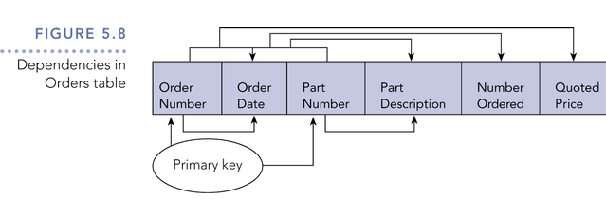
Dependencies in Orders Table

Slide 12
Progressing to 2NF
If a table is not in second normal form
    Move that data item and the part of the primary key on which it is functionally dependent to a new table.
    Add any other data items are functionally dependent on the same part of the key
    Make the partial primary key the primary key for the new table.
Notes:
49
An attribute that is not part of the primary key is a non-key attribute
A table with a single primary key is automatically in 2NF
E.g.: Bankcard (creditcard#, VendorID, date-time, VendorAddress, amount)

Slide 13
Third Normal Form
A table is in third normal form (3NF) if it is in second normal form and if the only determinants it contains are candidate keys.
Similar update anomalies: Updates, inconsistent data, additions, deletions.
Notes:
Recall that any column (or collection of columns) that determines another column is called a determinant.
3NF is violated when a non-key field is a fact about another non-key field

Slide 14
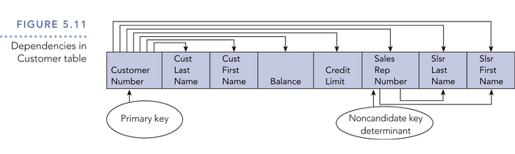
Dependencies in Customer Table

Slide 15
Progressing to 3NF
Move all items involved in transitive dependencies to a new entity
Identify a primary key for the new entity
Place the primary key for the new entity as a foreign key on the original entity
Notes:
50
The normal forms are nested i.e. a table in 3NF is also in 2NF and 1NF
A transitive dependency is a functional dependency between two (or more) non-key attributes
Transitive dependencies lead to deletion and insertion anomalies
If all non-key fields are mutually independent, there are no transitive dependencies

Slide 16
Boyce-Codd Normal Form
A table is in BCNF if every determinant is a candidate for the primary key
Anomalies occur if :
  The table has more than one candidate primary key.
  The candidate keys are composite.
  The candidate keys share a common data item.
Notes:
51
BCNF is a stronger version of 3NF
It is the new 3NF
If the table is not in BCNF could have update anomalies
For a table where the combination of the three conditions stated above do not occur, 3NF is equivalent to BCNF

Slide 17
Progressing to BCNF
Place the two candidate primary keys in separate entities.
Place each of the remaining data items in one of the resulting entities according to its dependency on the primary key
Notes:
52
BCNF is conceptually simpler than 3NF since it makes no reference to 1NF, 2NF, or transitive dependencies
E.g.: SJT(student, subject, teacher)
Overlapping candidate keys:
(student, teacher)
(student, subject)

Slide 18
Multivalued Dependence
In a table with columns A, B, and C, there is a multivalued dependence of column B on column A, if each value for A is associated with a specific collection of values for B and, furthermore, this collection is independent of any values for C.
A table is in fourth normal form (4NF) if it is in 3NF and there are no multivalued dependencies.
Notes:
E.g.: (employee, skill, language)
Two many-to-many relationships that are independent because any skill can be paired with any language
Can remove repeating groups and expand primary key to get:
(employee, skill, language)
But you still have modification anomalies

Slide 19
Fourth Normal Form
A table is in fourth normal form (4NF) if it is in 3NF and there are no multi-valued dependencies
To remove multi-valued dependencies, create separate tables for the independent repeating groups
Notes:
Separate the independent repeating groups
Create two tables:
(employee, skill)
(employee, language)

